Slide 1




Take this Grading & Bin it: Simplify Lab Report Grading with the Bins-Based Grading System
Suzanne Thuecks,
Washington College
Dan Johnson,
Wake Forest University
Notes:
1920 x 1080

Slide 2
Goals & Outline for Today
QUICK tour of how STEM & general writing teachers differ
Six Elements Model:
  Bins Grading and
  Reflective Coaching
How Dan uses bins in BioCore at Wake
How Suzanne uses bins in General Biology I and II at Washington College
Try it for yourself!

Slide 3
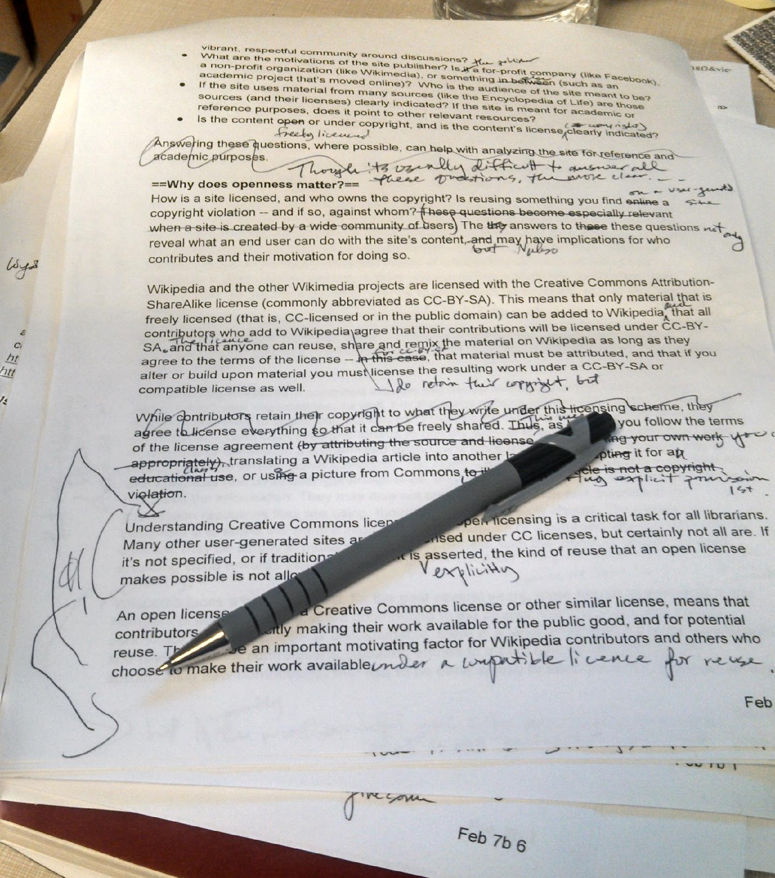
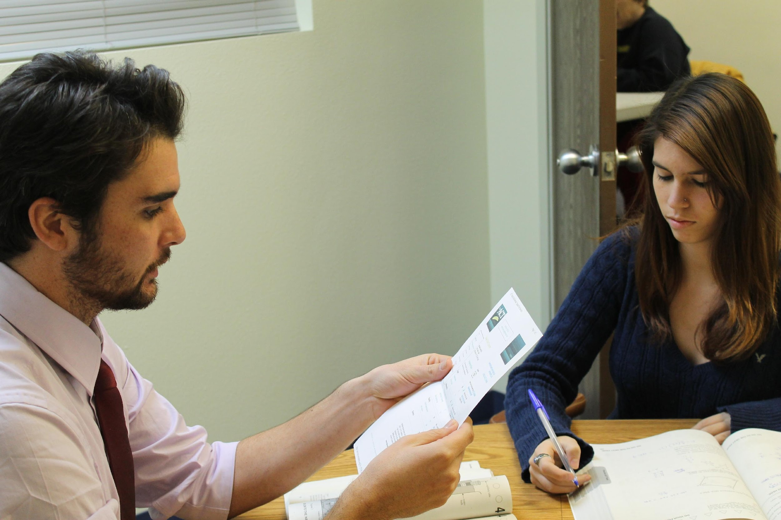
Tell the Truth…Is THIS Your Reality?

Slide 4
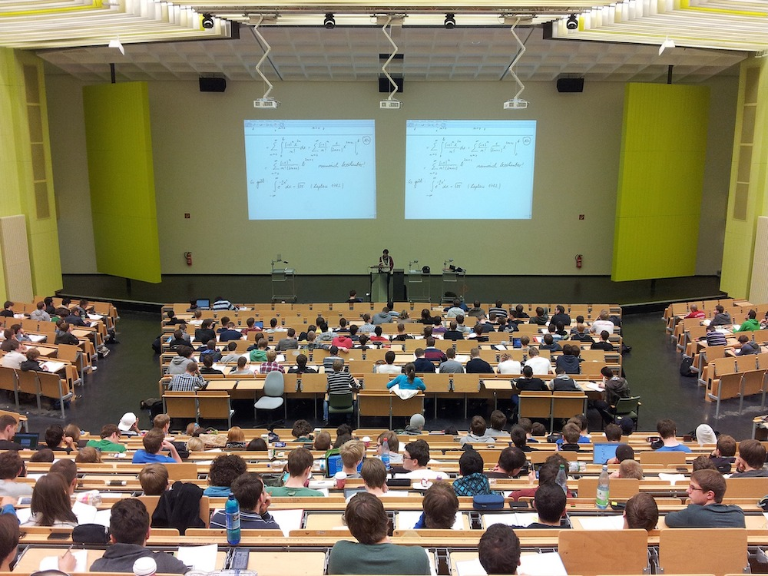


…Or Is THIS Closer to Your Reality?

Slide 5
How STEM Teaches Writing is NOT How Pros Do It
Program Design Differences |  |  | Instructor Differences
STEM Programs | Writing Programs |  | STEM Programs | Writing Programs
100s of students/ semester | 15/section, 60/semester |  | Extensive copy-editing | Less editing, more self-correction, coaching
GTAs; add-on goal | Professionals; 1º goal |  | Overload students with corrections | Limit feedback to biggest errors first
Ad hoc approach | Evidence-based practices |  | Mechanics >> structure | Structure >> mechanics
Assume goals, purpose are clear | Assess students; do they see goals, purpose? |  | What else??

Slide 6
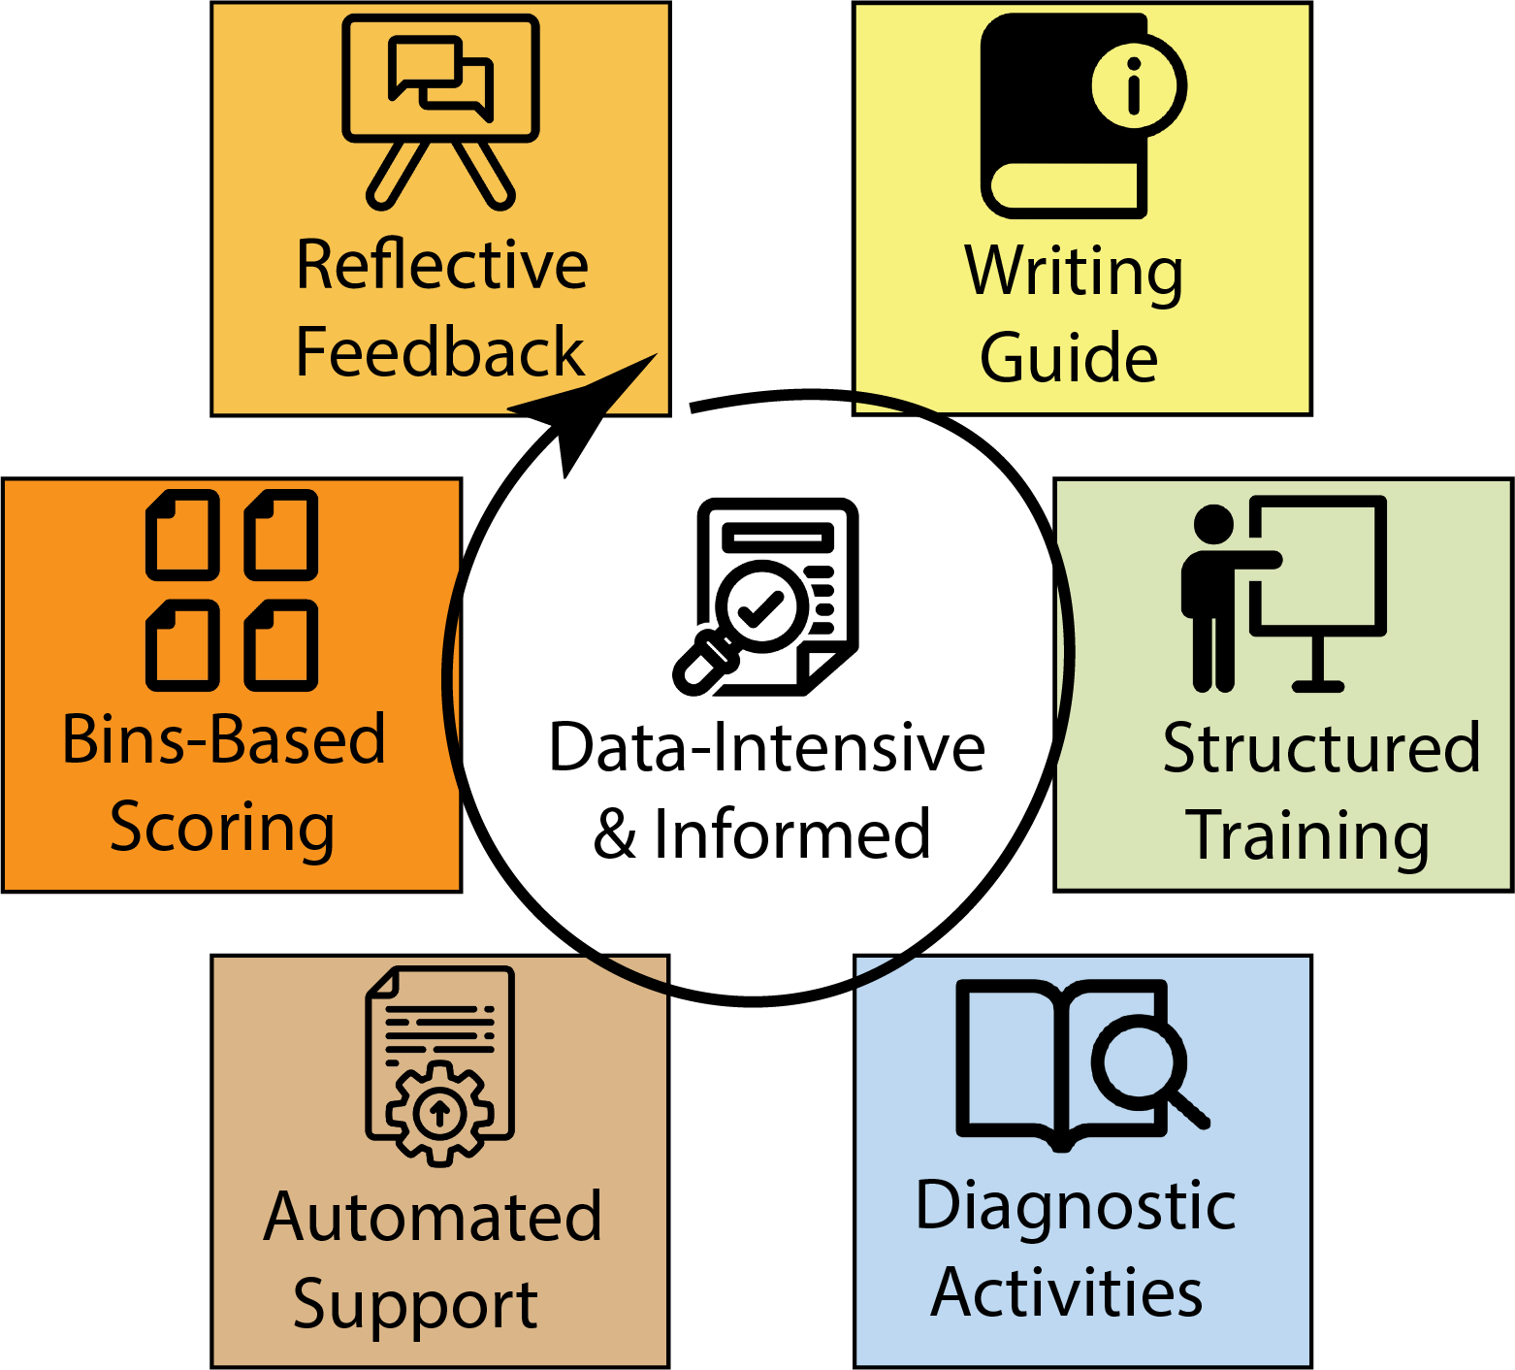

The Six Elements Model (SEM)
Adapts WAC/WID practices to STEM’s reality
  Improve on what works
  Remove what doesn’t
Leverage data science, computational methods
Make student experience more “authentic”
Give instructors time back
https://stemwritingproject.org/

Slide 7
How We Made Grading Simpler, More Informative
Make expectations clearer
Put less time into scoring, more into feedback
Limit feedback to what students can respond to
https://www.ableweb.org/volumes/advances-abstract/?ResourceId=3989

Slide 8
Wake’s Way: Bins-Based Scoring
Scores based on ~20 binary features:
  Meets all basic criteria?
  Are there flaws in writing, logic, or technical requirements?
Faster, fairer grading:
  Time for submission/revision
  Points arguments change to deeper discussions

Slide 9
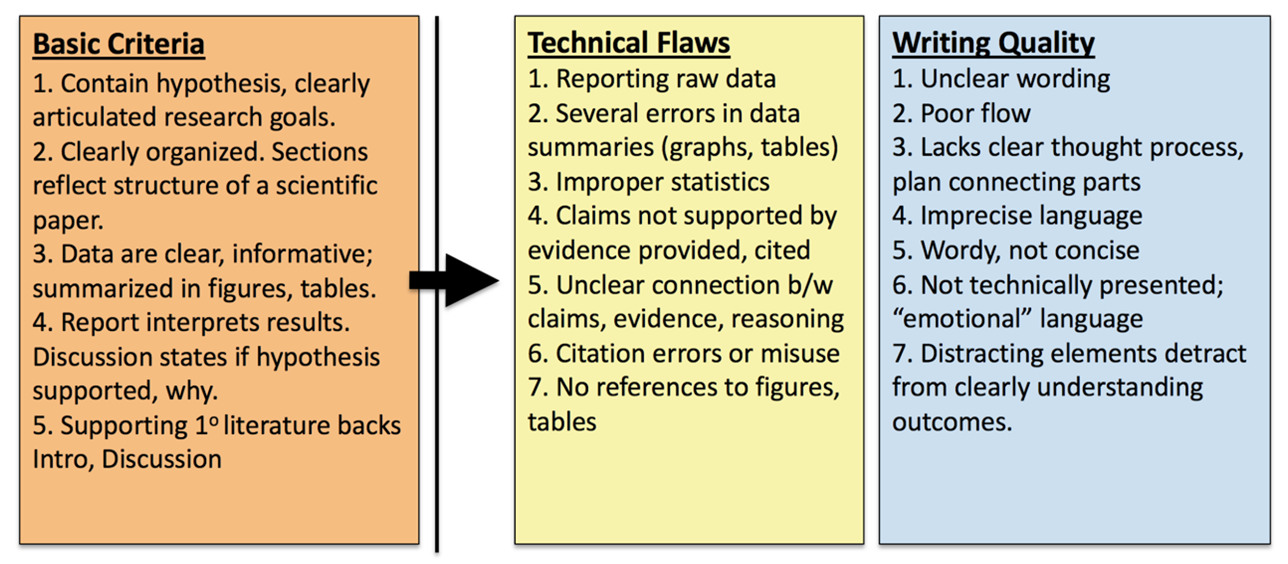
Wake’s ENTIRE Grading Rubric

Slide 10
How Wake’s Rubric Turns Into Bins, Grades
Submitted | Criteria | Bin Score | Equivalent %
No | Not submitted; plagiarized | 0 | 0%
Yes | Fails to meet 1+ basic criteria (max. score on revision = 3) | 1 | 55%
Yes | Meets 5 basic criteria; both technical and writing flaws | 2 | 75%
Yes | Meets 5 basic criteria; either technical or writing flaws | 3 | 85%
Yes | Meets 5 basic criteria; no major technical or writing flaws | 4 | 95%
Both draft, revised versions scored & commented

Slide 11
Wake’s Way: Reflective Feedback, Coaching
Student is in charge of improving, correcting
  Helps students learn to ask right questions about their OWN work
Limited/no copy editing
  Refer authors back to Writing Guide, training activities
  Look to 1º lit. for examples

Slide 12
Washington’s Way:
Peer review w/checklist during lab
Instructor grades next draft from 0-4 pts and gives reflective feedback
Instructor grades final draft by comparing to rough draft
  All feedback addressed adequately? Go up 1 grade bin
  Some feedback addressed? Give intermediate points
  No feedback addressed? Grade bin stays the same

Slide 13
Washington College Rubric/Bins
Submitted | Criteria | Rough draft score | Final draft score
No | Not submitted or plagiarized | 0 | 0% of available points
Yes | Major missing part(s), basic criteria not met | 1 | 65%
Yes | Major or pervasive flaws in technical and/or writing quality | 2 | 75%
Yes | Some flaws in technical and/or writing quality | 3 | 85%
Yes | Satisfactory, a few minor problems | 4 | 95%
Yes | Ready for publication | Not available | 100%

Slide 14
Try Bins Grading Yourself!
Each group will work together on 1-2 reports from Google Drive
Choose criteria to use
Choose a “bin” for a grade and decide on most relevant feedback

Slide 15
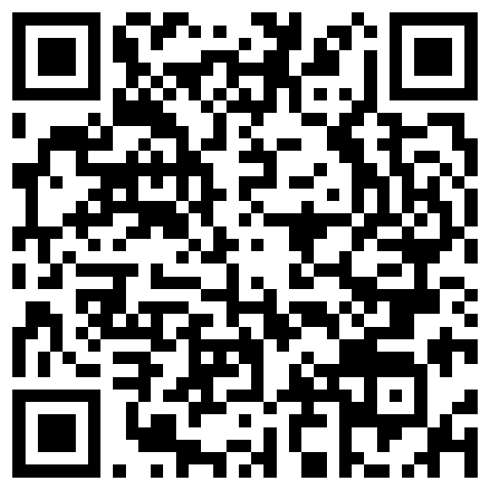
THANKS for coming today!
Check out add’l project resources in ABLE’s workshop folder
Fill out evaluation!
Notes:
1920 x 1080

